Slide 1
Data Structures and Algorithm Analysis – Sorting
--By Shengli
2019.08

Slide 2
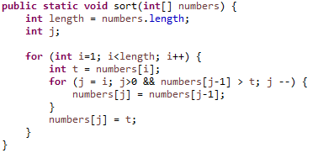
插入排序(Insertion Sort)
34 | 8 | 64 | 51 | 32 | 21
Insert 8 into {34}
8 | 34 | 64 | 51 | 32 | 21
Insert 64 into {8, 34}
8 | 34 | 64 | 51 | 32 | 21
Insert 51 into {8, 34, 64}
8 | 34 | 51 | 64 | 32 | 21
Insert 32 into {8, 34, 51, 64}
8 | 32 | 34 | 51 | 64 | 21
Insert 21 into {8, 32, 34, 51, 64}
8 | 21 | 32 | 34 | 51 | 64

